Slide 1
2022 Election Chief Statistician briefing
Ian Cope - Chief Statistician & Director of Statistics & Analytics
5 May 2022

Slide 2
Content
Role of the Chief Statistician & Director of Statistics and Analytics
General Election and statistics
Statistics Jersey structure and outputs
Statistics Users Group; Public Authority Statistics; and Official Statistics
Code of Practice for Statistics
Code of Practice for Official Statistics
Statistics teams in government
What Statistics are available from statisticians and analysts across government?
What sustainable wellbeing for indicators for Jersey are available?
What statistics are available on government performance?

Slide 3
Background
This presentation is, by necessity, content heavy
It is designed to signpost election nominees and candidates to the statistical information from Government of Jersey in which they might be interested
Links are provided to the key data sources
The video of this presentation will be posted to vote.je along with the presentation (for ease of accessing links)

Slide 4
Chief Statistician & Director of Stats & Analytics
Fulfils the statutory role of Chief Statistician
Leads Statistics Jersey - a robust, independent statistical service; make executive decisions for official statistics, seeking advice from the Statistics Users Group
Government’s principal adviser on the measurement and analysis of official statistics
Development and maintenance of a coherent statistics framework
Leads on career and professional development for Statisticians and Analysts in departments
Build the capability and capacity of statisticians and analysts across the public service
Ensure the highest professional standards, methodologies and reporting

Slide 5
Chief Statistician statutory functions:
Under Statistics and Census Law 2018, Chief Statistician responsible for:
Leading Statistics Jersey
“In exercising any of its functions, Statistics Jersey has the right to act independently”
“the content of statistical releases and publications issued by Statistics Jersey”
“commenting on the quality and interpretation of any statistics produced by public authorities, other undertakings and individuals”
Ensuring compliance with the Code of Practice for Official Statistics

Slide 6
General Election and statistics
The Pre-election period begins on 11 May Standing in the 2022 General Election - Vote.je - States of Jersey Elections
During the election period Statistics Jersey will continue to publish pre-announced official statistics but will not publish ad-hoc stats
In practice only the Index of House Prices on 19 May falls within the election period
Public Health will continue to publish regular weekly/monthly Covid statistics
Statisticians and analysts should respond to FoI data requests as normal

Slide 7
Statistics Jersey structure
Ian Cope – Chief Statistician Director of Analytics and Statistics
Dan Edmunds – Deputy Chief Statistician
(Principal Statistician)
Senior Statistician – Leading on population / social statistics (Census Manager)
Population estimates and projections
Senior Statistician
Leading on economics statistics
GVA and GDP
Temporary staff employed to assist with LCHIS (Living cost and household income survey) and Census
Statistician
Census (in non-census years: School survey, Opinion’s and lifestyle survey), Living Costs and Household Income Survey
Assistant Statistician
Temporary contract
Assistant Statistician
Labour market
Business Tendency survey, Survey of Financial Institutions
Assistant Statistician
House Price Index, Actively seeking work, Average Earnings
Assistant Statistician
RPI, Energy trends
Assistant Statistician
Tourism statistics, Census and household survey support
Assistant Statistician – Fixed term contract
Statistical officer
Temporary contract
Statistical officer
Temporary contract

Slide 8
Statistics Jersey Economic Statistics outputs
Economic Stats
Covid support (quarterly)
RPI (quarterly)
Business Trends Survey (quarterly)
Actively Seeking Work (quarterly)
House Price Index (quarterly)
Labour Market (June & December)
Index of Average Earnings (annually)
National Accounts (annually)
Energy Trends (annually)
Telecoms Statistics (annually)
Survey of Financial institutions (annually)
Purchasing Power Parity (every 6 years)

Slide 9
Statistics Jersey Social Statistics outputs
Social stats
Jersey Opinions & Lifestyle Survey (annually)
Population estimates (annually)
Children and Young Persons Survey (every 2 years)
Better Life Index (every two years)
Living costs & Household Income Survey (every ~4 years). Provides:
Income Distribution analyses
Expenditure analyses
Weights for RPI ‘basket of goods’
Last full LCHIS was in 2014/15
2019/20 was curtailed due to Covid
Survey restarted in September 2021
Population and household projections (every 5 years)
Census (decennial)
Statistics Jersey also: Provide support for FOIs, States Assembly questions, additional analyses on outputs, assisting other depts with survey design and content, etc.

Slide 10
How to find Statistics Jersey releases
Dates for Statistics Jersey forthcoming releases are in the 12 month ahead release schedule Publication release schedule (Statistics Jersey) (gov.je)
Already published Statistics Jersey statistical releases are in the reports webpage Statistics Jersey reports and documents (gov.je)
Information about the independent Statistics Users Group is here Statistics Users Group (gov.je)

Slide 11
Statistics Users Group (SUG)
Existed informally prior to 2018; The Statistics Law put SUG on a statutory basis
“The Group is independent of government and has the primary function of overseeing the quality, relevance and integrity of statistics compiled by or on behalf of a public authority. “
The Stats Law states that “the [Statistics Users] Group must publish:
a Code of Practice for Official Statistics in Jersey including any revisions of the code”

Slide 12
Public Authority & Official Statistics
‘Public Authority Statistics’ are those produced by public authorities other than Statistics Jersey and are governed by the Code of Practice for Statistics Code of Practice for Statistics 2019.pdf (gov.je)
Official Statistics are defined by the Statistics Law as those produced by Statistics Jersey and listed in the Statistics Jersey release schedule
Statistics Jersey complies, in addition, with the Code of Practice for Official Statistics Code of Practice for Official Statistics 2019.pdf (gov.je) which requires:
All Statistics Jersey outputs be pre-announced in a release schedule
“Official statistics must comply with the principle of equality of access. Therefore, access before the public release of official statistics should be strictly limited to those individuals directly involved in the production of the statistics and the preparation of the release.”

Slide 13
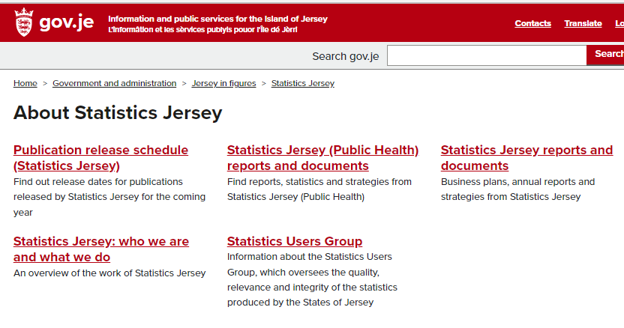
Statisticians and analysts in government
Official Statistics produced by:
Statistics Jersey
Public Authority Statistics produced by:
HCS Informatics team
Public Health Intelligence
CYPES Informatics
T&E Analytics & MI Team +Tax analysts
CLS Information Analysts
HR Analysts in COO
Police Analysts
Safeguarding Partnerships Board

Slide 14
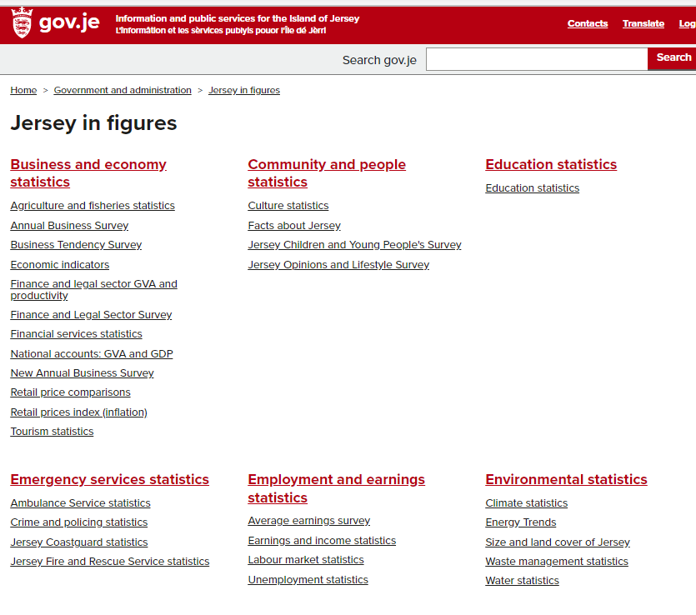
What Statistics are available from the rest of GoJ
‘Jersey in Figures’ webpage collates statistics from across government Statistical data for Jersey (gov.je)
Some are more up-to-date than others. Includes statistics on:
Education
Crime
Business & economy (including agriculture and fishery statistics)
Public Health– which includes a forward release schedule Public Health Intelligence publication release schedule (gov.je)
Health
Emergency services
The Environment
Housing and living
Government accounts/spending and income
Travel and transport

Slide 15
Sustainable wellbeing statistics
The Public Finances (Jersey) Law 2019 requires the Council of Ministers to take into account the sustainable wellbeing of current and future generations when they develop the Government Plan
Sustainable wellbeing focuses on long-term progress rather than short-term intervention, and measures:
Community wellbeing - the quality of people’s lives
Environmental wellbeing – the quality of the natural world around us
Economic wellbeing – how well the economy is performing

Slide 16
Future Jersey
The Future Jersey ‘My Jersey’ Island engagement identified ten sustainable wellbeing topics that Islanders regarded as important:
Children
Health and wellbeing
Safety and security
​Vibrant and inclusive community
Affordable living
Business environment
Jobs and growth
​Built environment
​Natural environment
Sustainable resources

Slide 17
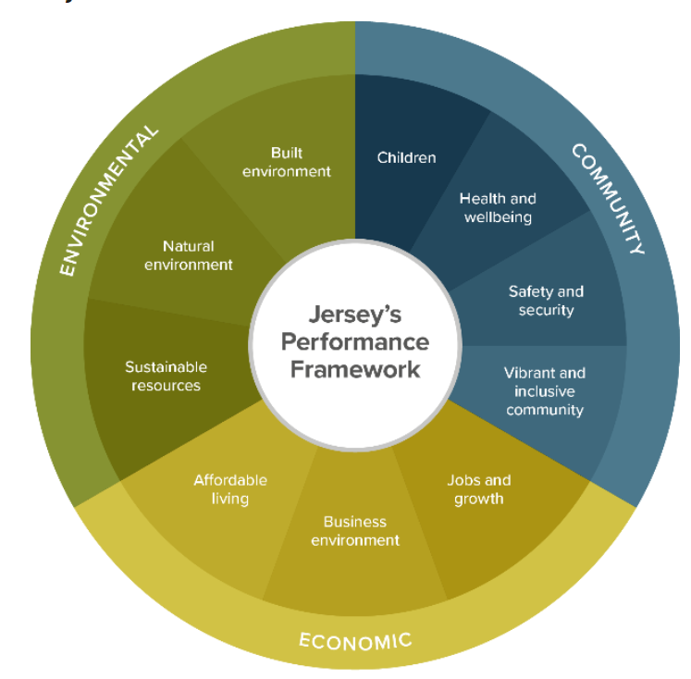
Island Outcomes and Indicators
These ten topics are organised around the three aspects of sustainable wellbeing:
Community wellbeing
Environmental wellbeing
Economic wellbeing
There is a wealth of data about the Island in the ‘Island Outcomes and Indicators’ part of the website Jersey Performance Framework (gov.je)

Slide 18
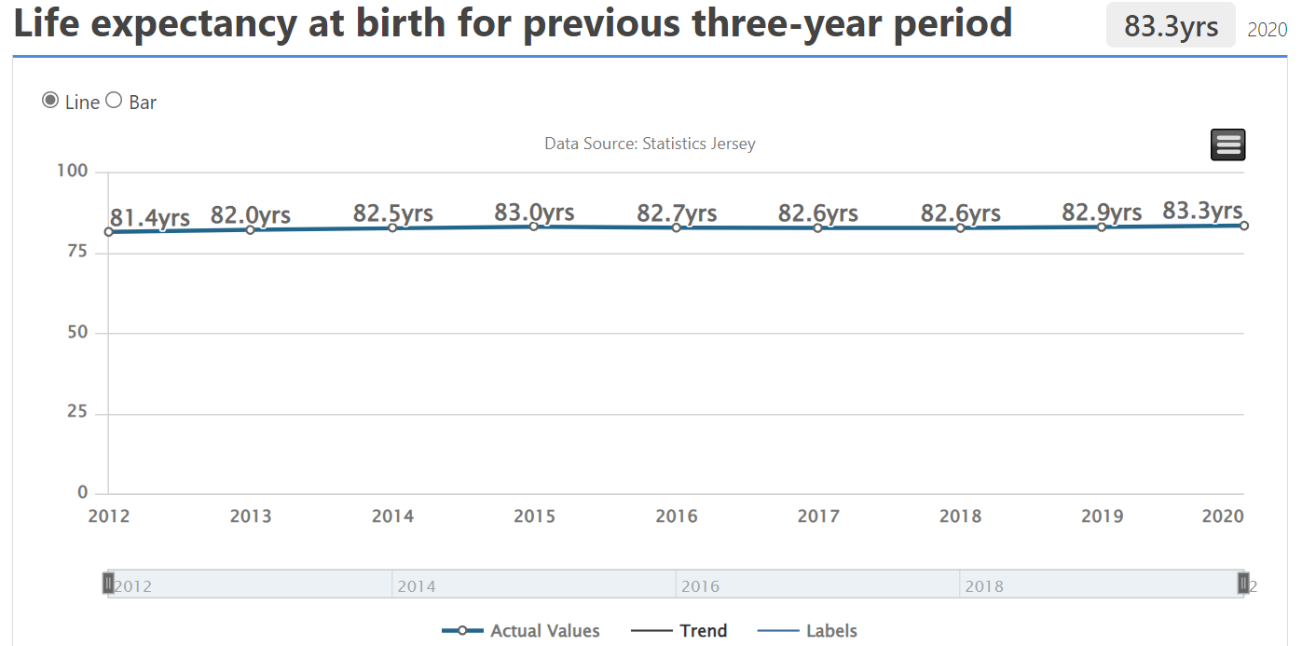
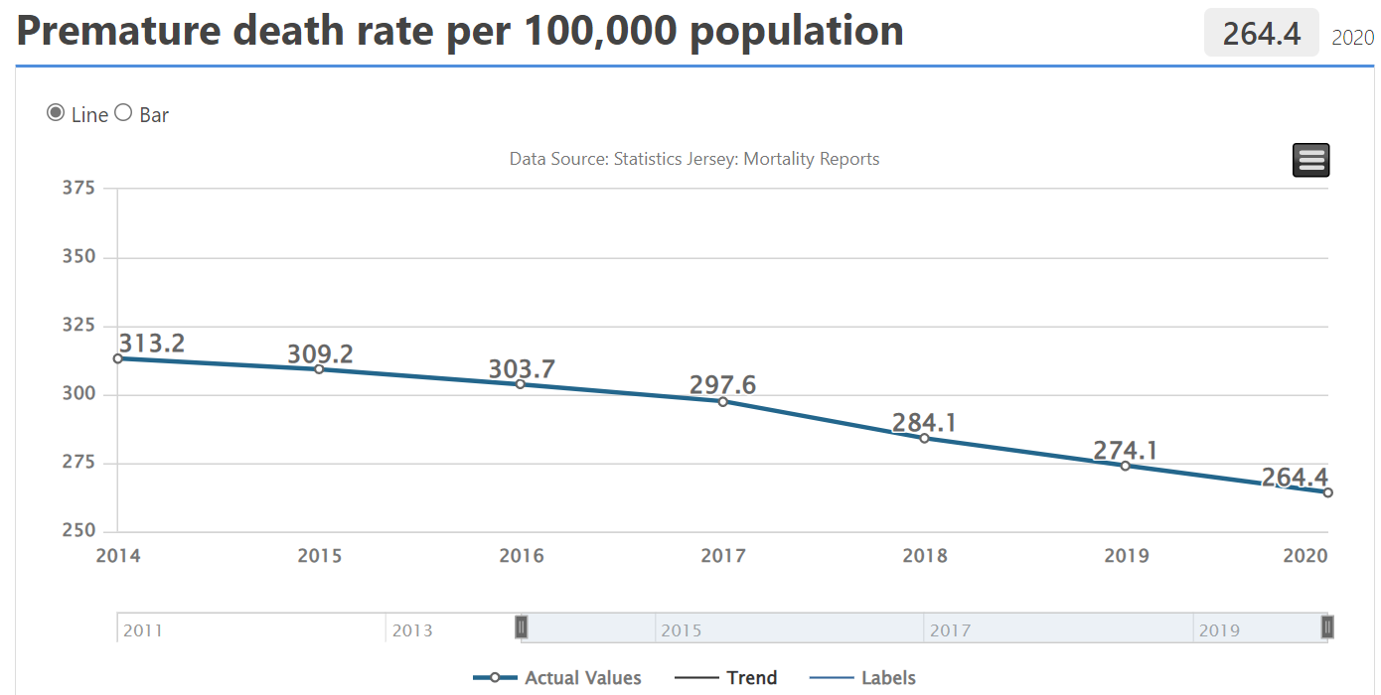
These Island Outcomes have a series of indicators
For example, ‘​Health and wellbeing’ has five topics, including ‘Islanders benefit from healthy lifestyles’.
This includes a theme ‘Jersey has a healthy population’ which has seven associated indicators

Slide 19
Service Performance Measures
Unlike the Island Outcomes and Indicators, which focus on long-term progress, the Departmental Service Performance Measures focus on in-year performance against targets set by departments
Customer experience data is also provided
Most service performance measures have a RAG status assigned, and sometimes notes for context

Slide 20
Service Performance Measures
The Service Performance Measures and targets are included in the Departmental Operational Business Plans, which are updated at the start of each year Departmental Operational Business Plans 2022 (gov.je)
There are 223 Service Performance Measures for 2022
Outcomes against the measures are updated online quarterly Performance Measures 2021 (gov.je) – Q1 2022 data will be published shortly
For some measures (e.g. exam results) updates can only be done annually

Slide 21
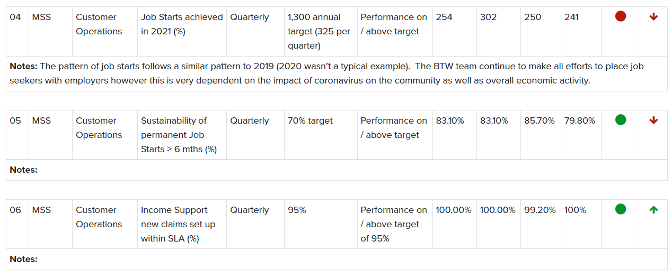
Presentation of Service Performance data
The data is in a standard format for each department
Below is an example from CLS
Direction of travel & RAG status
Minister
Description
Baseline
Target
Out-turn
RAG status

Slide 22
Links to Government of Jersey data sources
Statistics Jersey Publication release schedule (Statistics Jersey) (gov.je)
Statistics Jersey data Statistics Jersey reports and documents (gov.je)
Jersey in Figures data Statistical data for Jersey (gov.je)
Island Outcomes and Indicators (Sustainable Wellbeing indicators) Jersey Performance Framework (gov.je)
Departmental Operational Business Plans 2022 (gov.je)
Service Performance Measures Performance Measures 2021 (gov.je)
Statistics and Census (Jersey) Law 2018 STATISTICS AND CENSUS (JERSEY) LAW 2018 (jerseylaw.je)
Statistics Users Group Statistics Users Group (gov.je)
Code of Practice for Statistics Code of Practice for Statistics 2019.pdf (gov.je)
Code of Practice for Official Statistics Code of Practice for Official Statistics 2019.pdf (gov.je)

Slide 23
I’ll stop recording now
Opportunity for Questions

